Slide 1
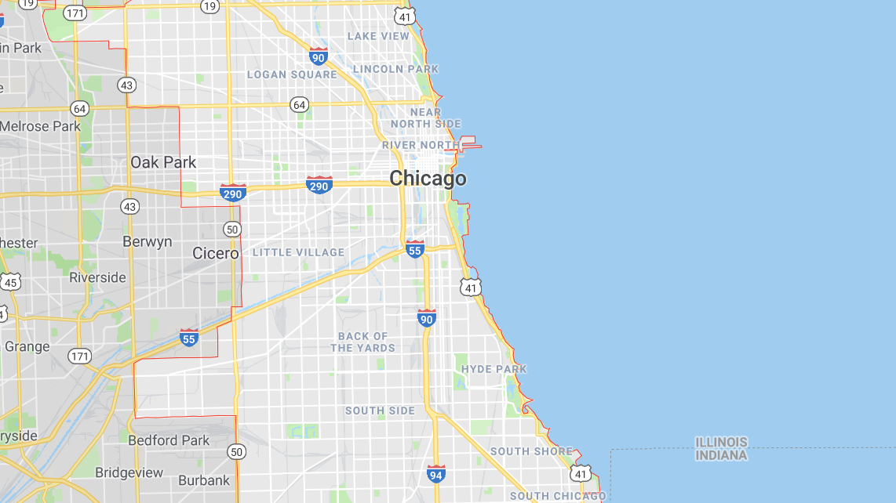
Chicago Traffic Cams & Accidents
Griffin Peifer, Mike Considine, Eddie Licea

Slide 2
Project Motivation & Overview
Why Traffic Cams & Accidents?
We’ve all gotten traffic cam tickets in the past couple years, so we wanted to analyze Chicago city traffic data to identify trends that might help us avoid unfortunate situations like traffic cam violations or accidents in the future
Questions/ Phases of Analysis
What are some observable trends or tendencies we can identify related to car accidents in Chicago
How have the most active traffic cameras and camera violation trends changed over time?
Why have these trends changed the way they have?
(How do they correlate to Chicago’s population or ride share data?)

Slide 3
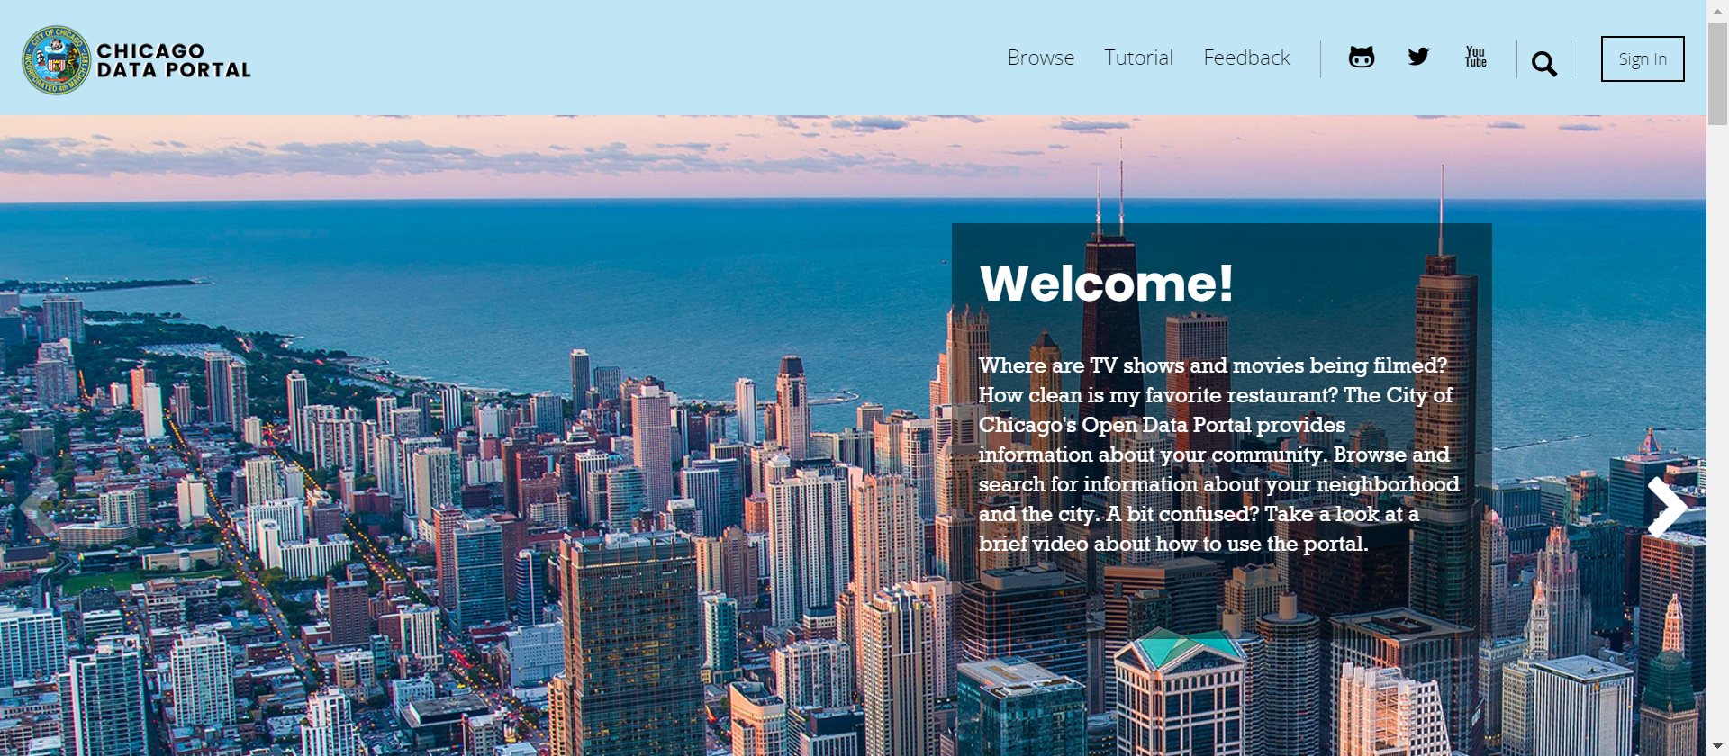
Chicago Traffic Data Source
Data Source – Chicago Data Portal https://data.cityofchicago.org/

Slide 4
Data Cleanup & Exploration
Three Primary Data Sets
Post 2017-2018 Accident Data
Considered the impact of the following on accidents:
Weather conditions
Lighting conditions
Time of year
Part of the city
Red Light Traffic Camera Data
Speed Camera Data

Slide 5
PLOT SHOTS

Slide 6
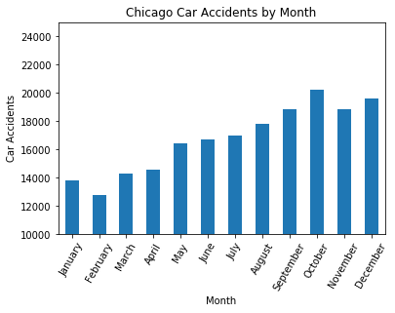
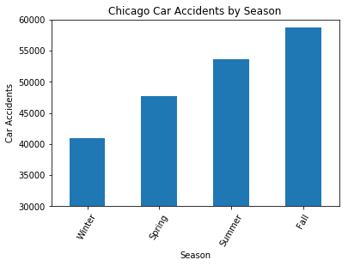
Analysis (1) – Car Accident Observations

Slide 7
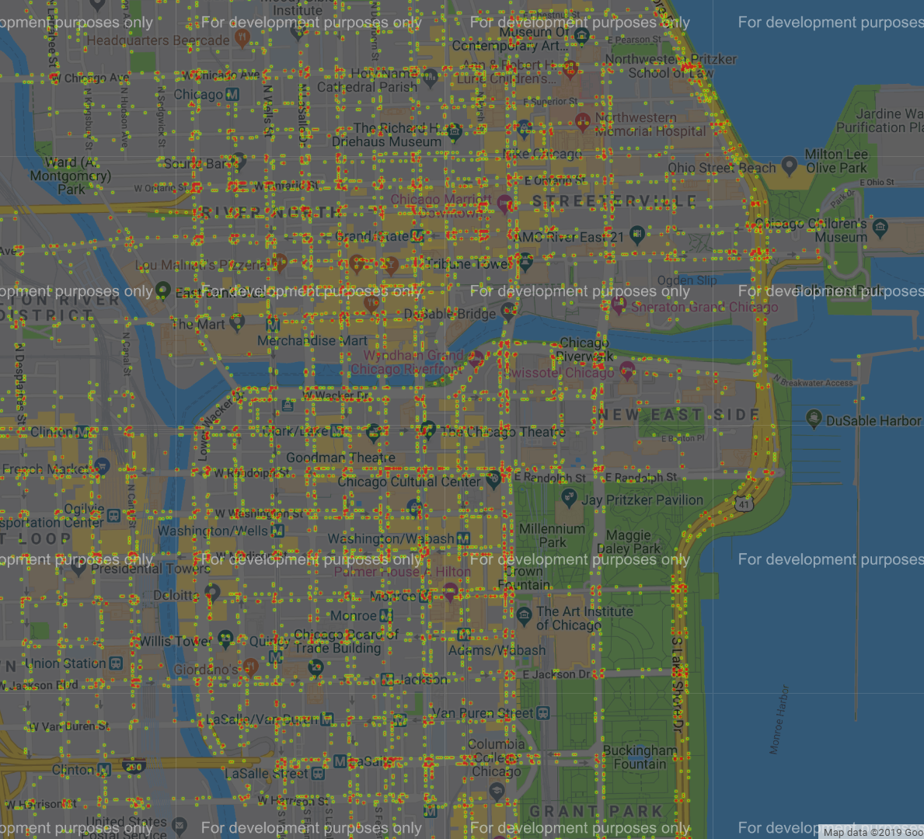
Analysis (1) – Total Car Accidents Heatmap
*Includes car accidents from 2017-2018

Slide 8
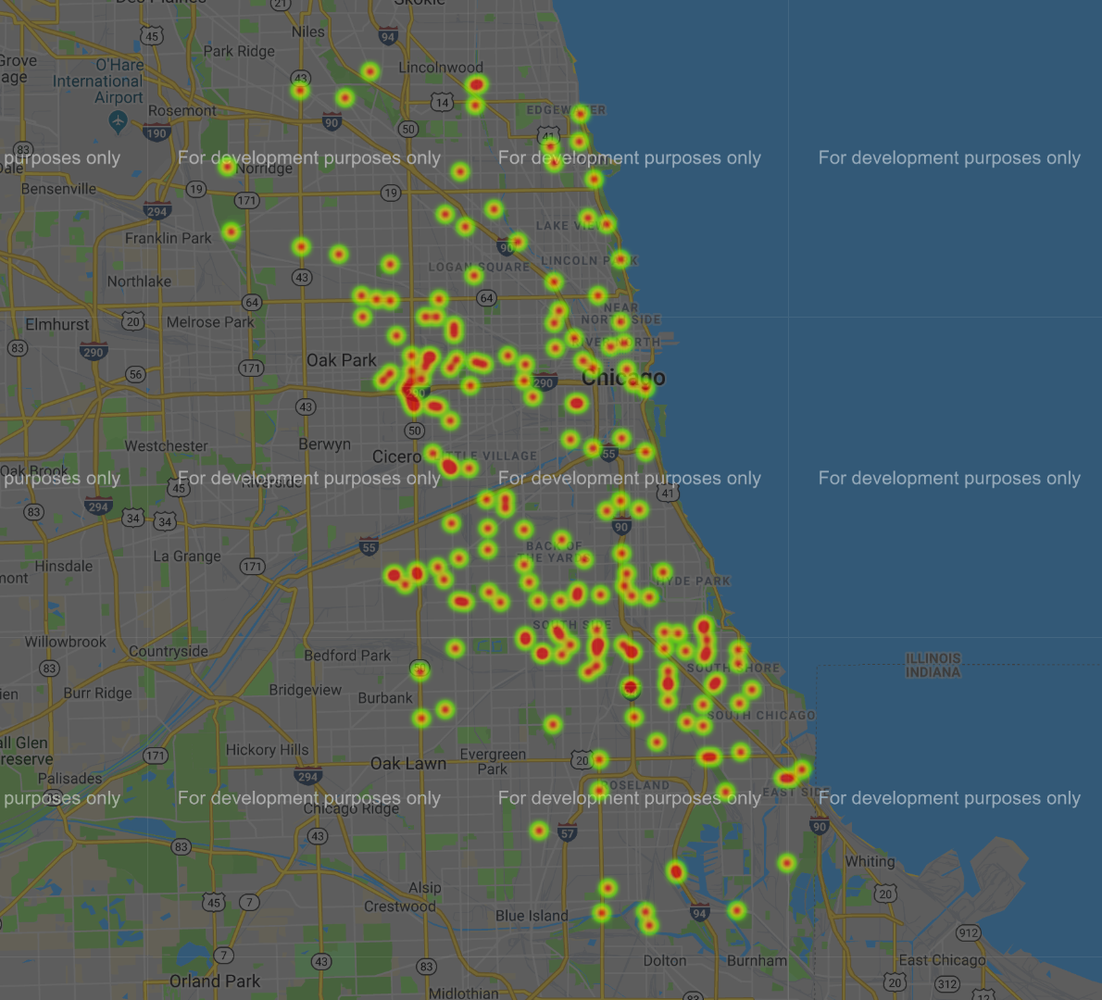
Analysis (1) – Fatal Car Accidents Heatmap
*Includes all car accidents with at least one fatality between 2017-2018
View the fatal car accidents details table in Jupyter Notebook for additional information

Slide 9
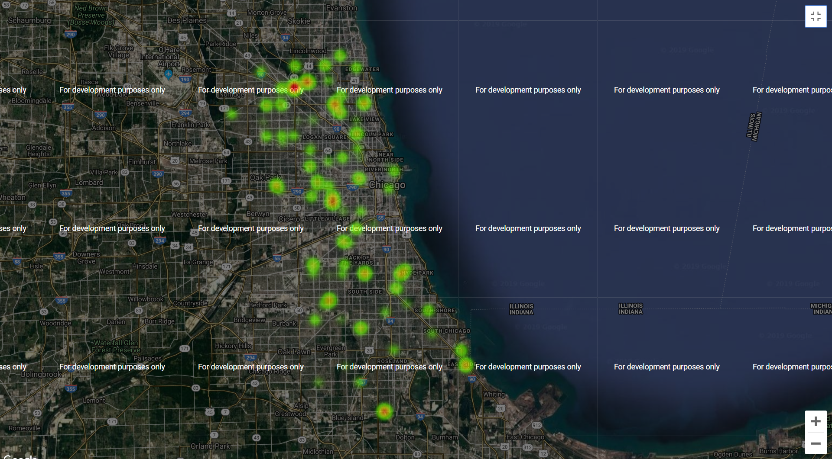
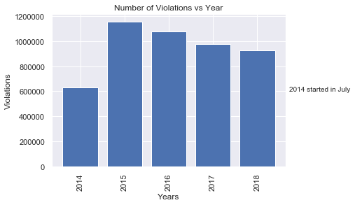
Analysis (1) – Speed Camera Violations

Slide 10
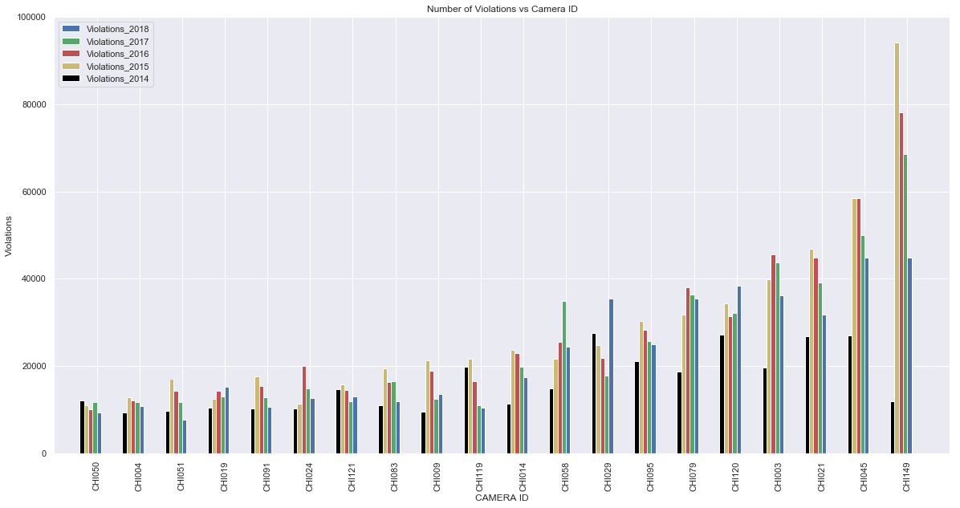
Analysis (2) – Top 20 Most Active Speed Cameras

Slide 11
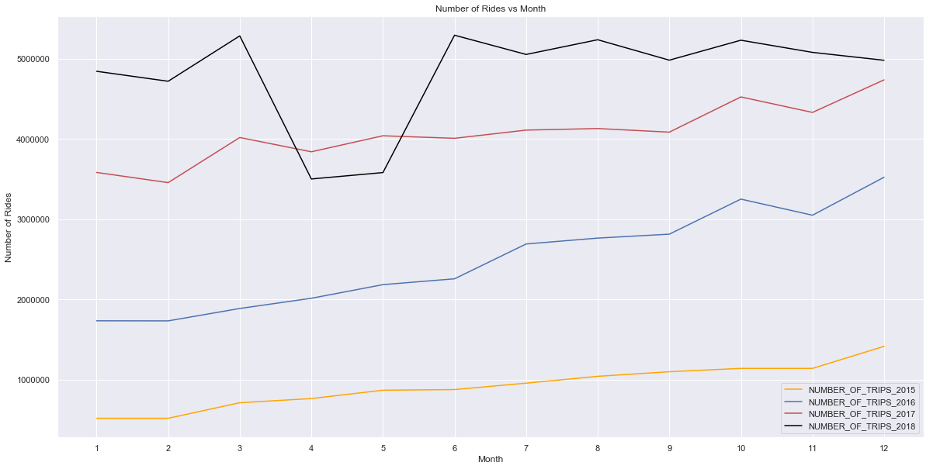
Analysis (3) – Rideshare Rides per Year

Slide 12
Analysis

Slide 13
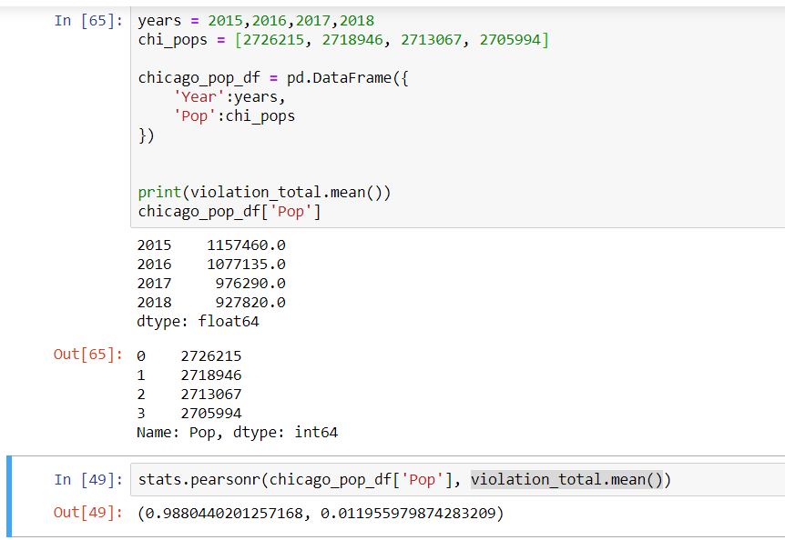
Analysis (3) – Pearson Correlation Test
Pearson correlation coefficient measures X and Y. This value has a range between -1, and 1., where 1 is a total positive linear correlation, and -1 is negative linear correlation

Slide 14
Discussion of Findings
Observations
Accidents
Accidents are most frequent in the fall, and least frequent in the winter. However, December had the second most accidents in the past two years
Accidents are most frequent in the heart of downtown, but fatal accidents happen most frequently on the outskirts of the city
Traffic Camera Trends

Slide 15
Post Mortem
Additional research options
Incorporating Chicago weather data to compare percentage of days in different conditions to the percentage of accidents in those conditions to better understand the cause of accidents
Honing the coordinate data of accidents in relation to traffic cameras to get a better idea of how much the camera additions contribute to an accidents
Obtaining more detailed data on ridesharing could help form a better picture of why Chicago traffic behaves the way it does

Slide 16
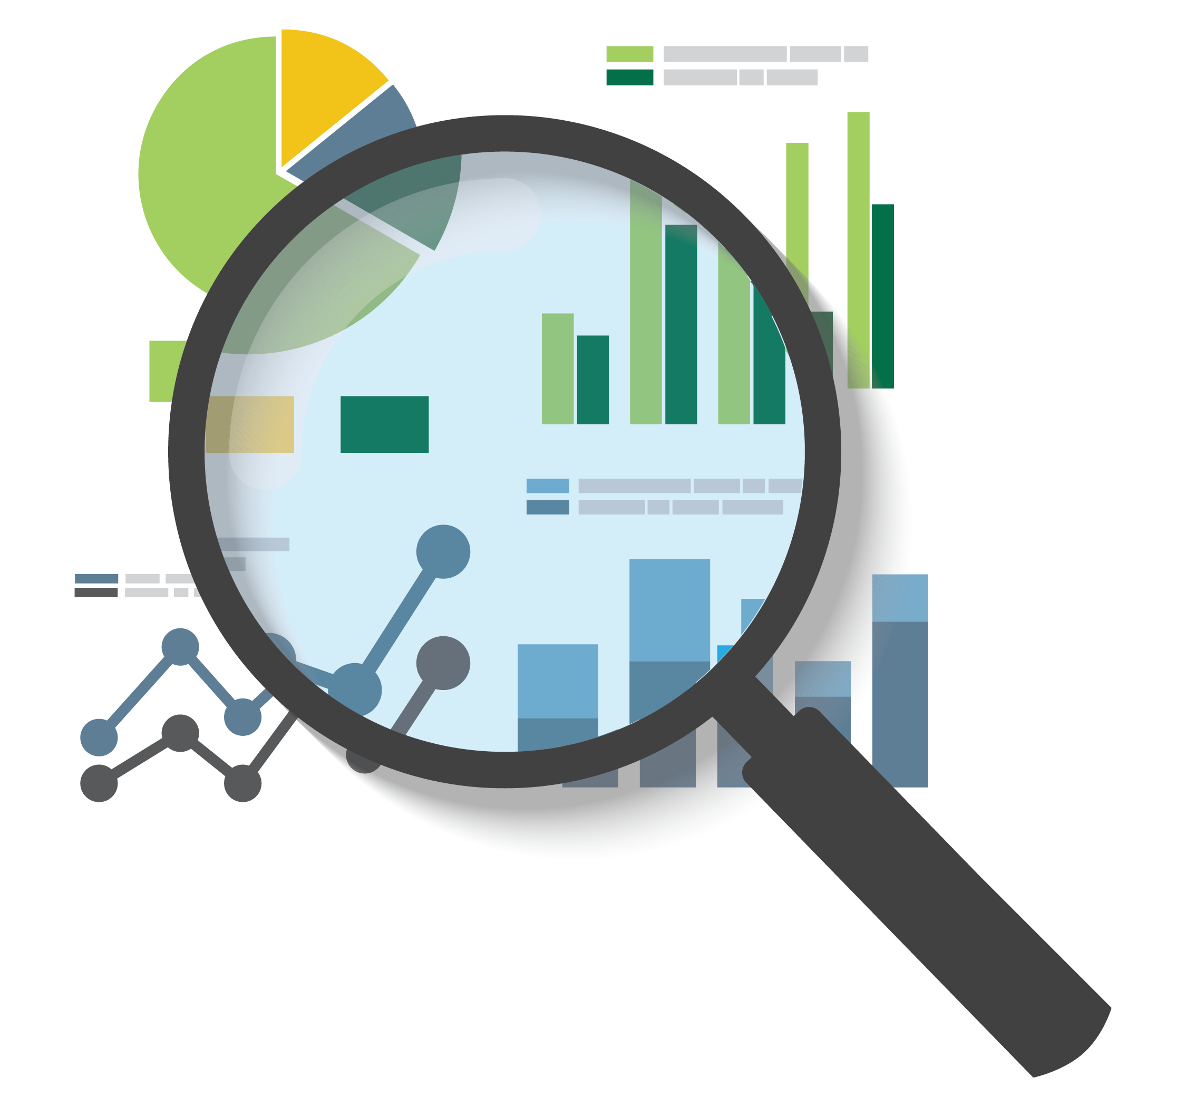
Task: (Red Light Traffic Cam Data)
Analyze
Discover trends
Visualize
With high hope of finding causality and a possible solution.
That’s were the rideshare data came in.

Slide 17

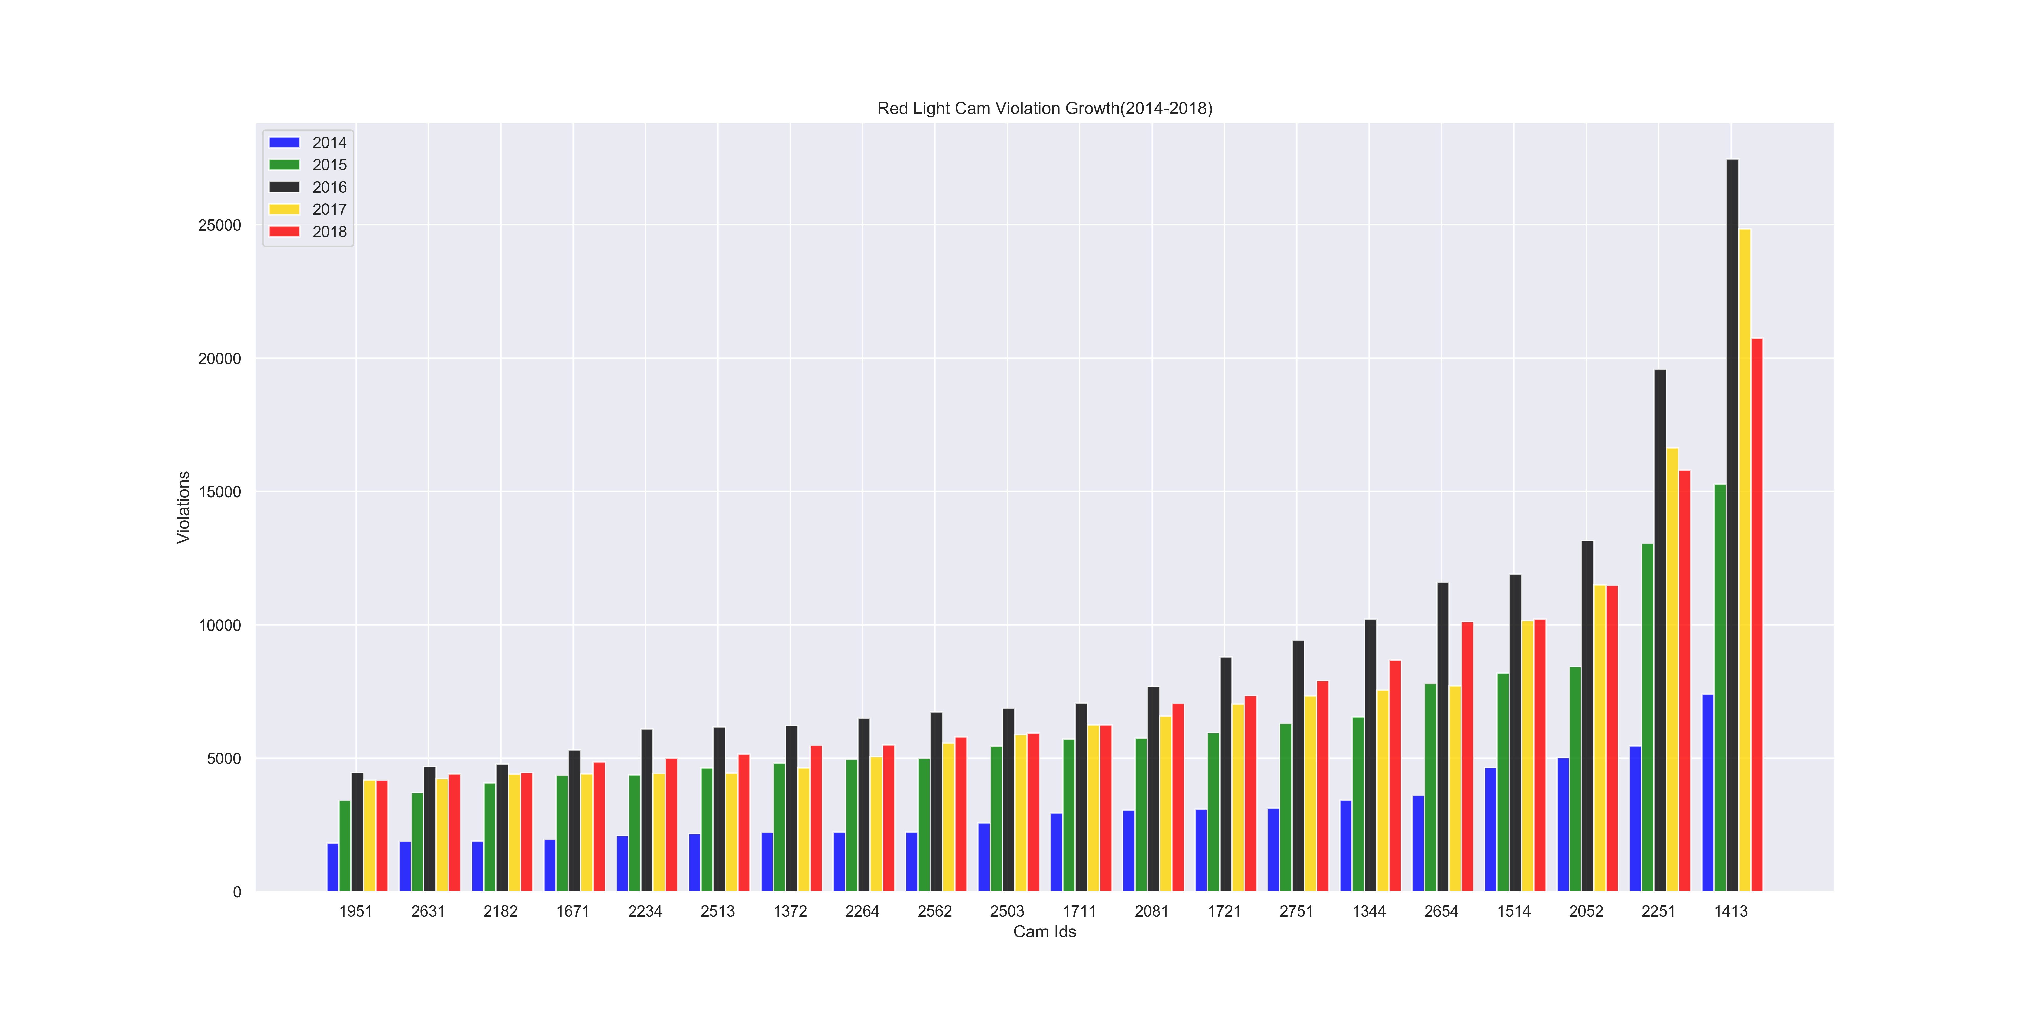
Red Light Camera Violation Growth (2014-2018)
Per Cam(Top 20)

Slide 18
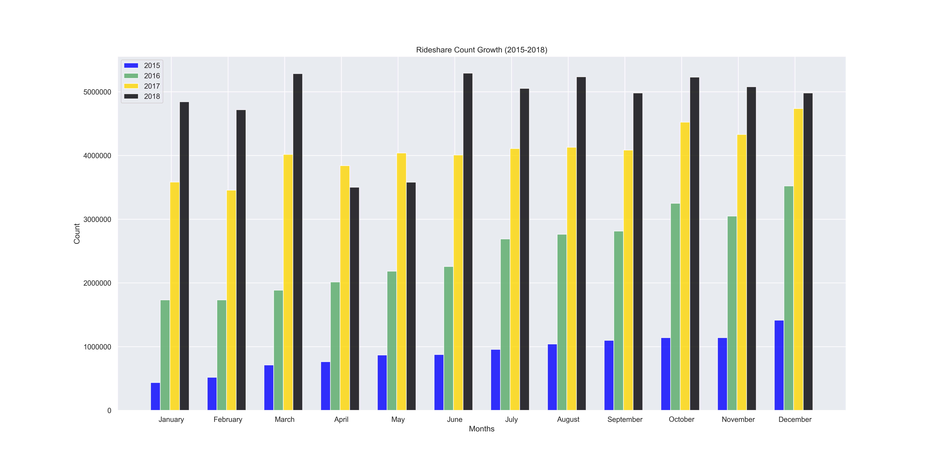
Rideshare Ride Count Growth (2015-2018) Per Month

Slide 19
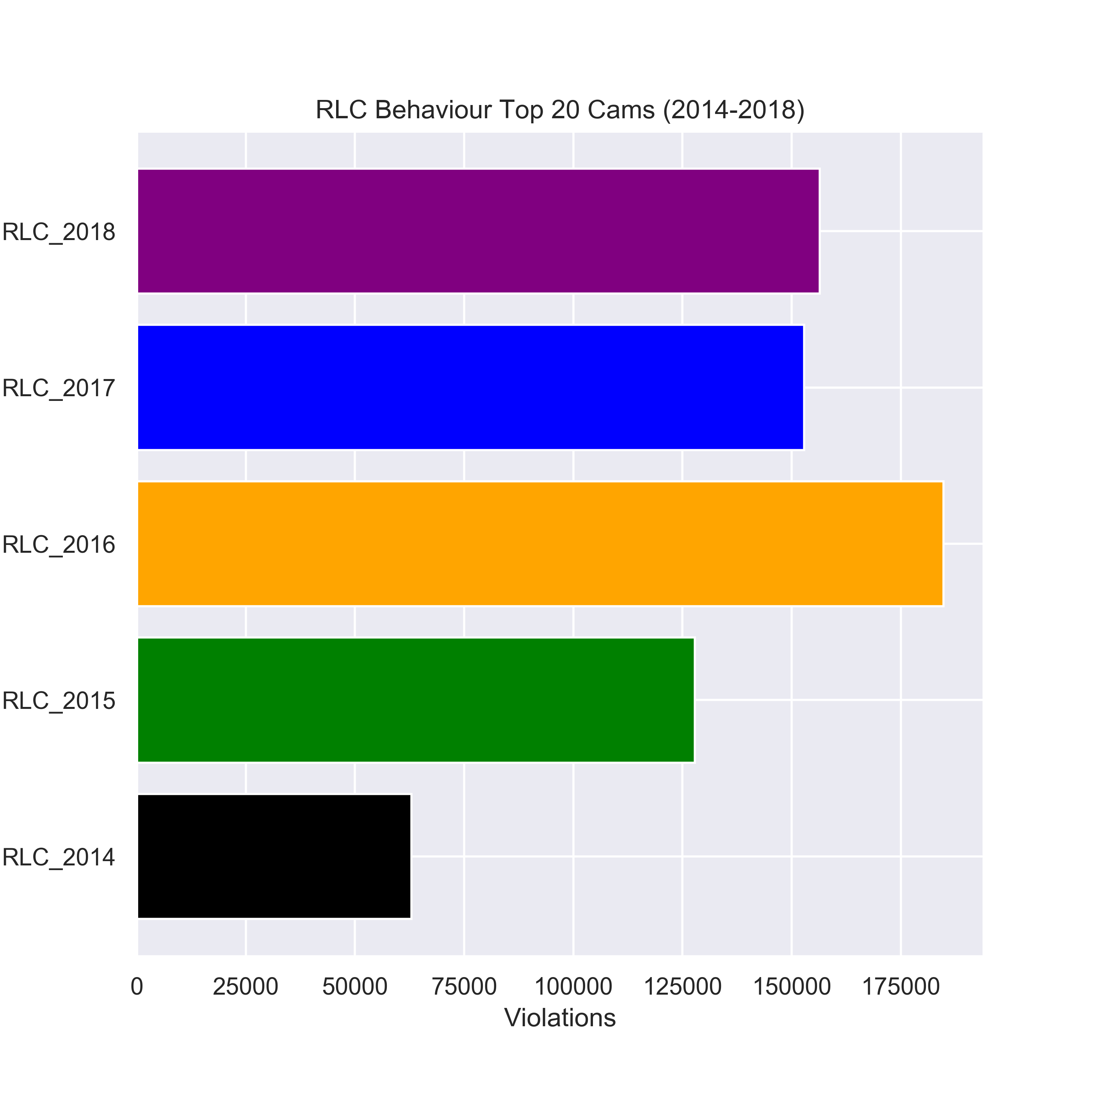
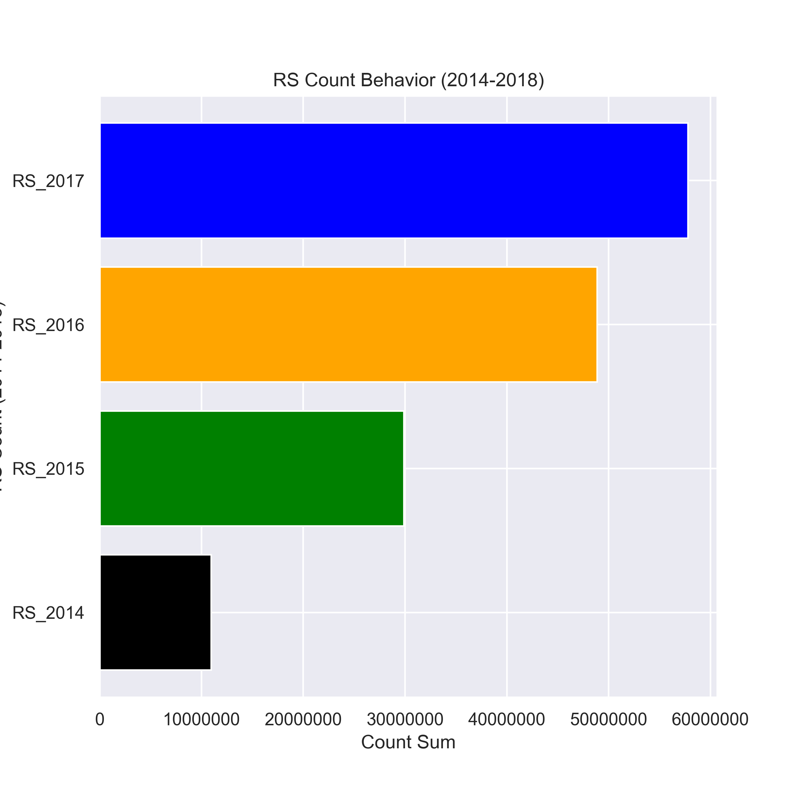
Red Light Camera Violation Growth (2014-2018)
Ride Share Count Growth
(2015-2018)

Slide 20

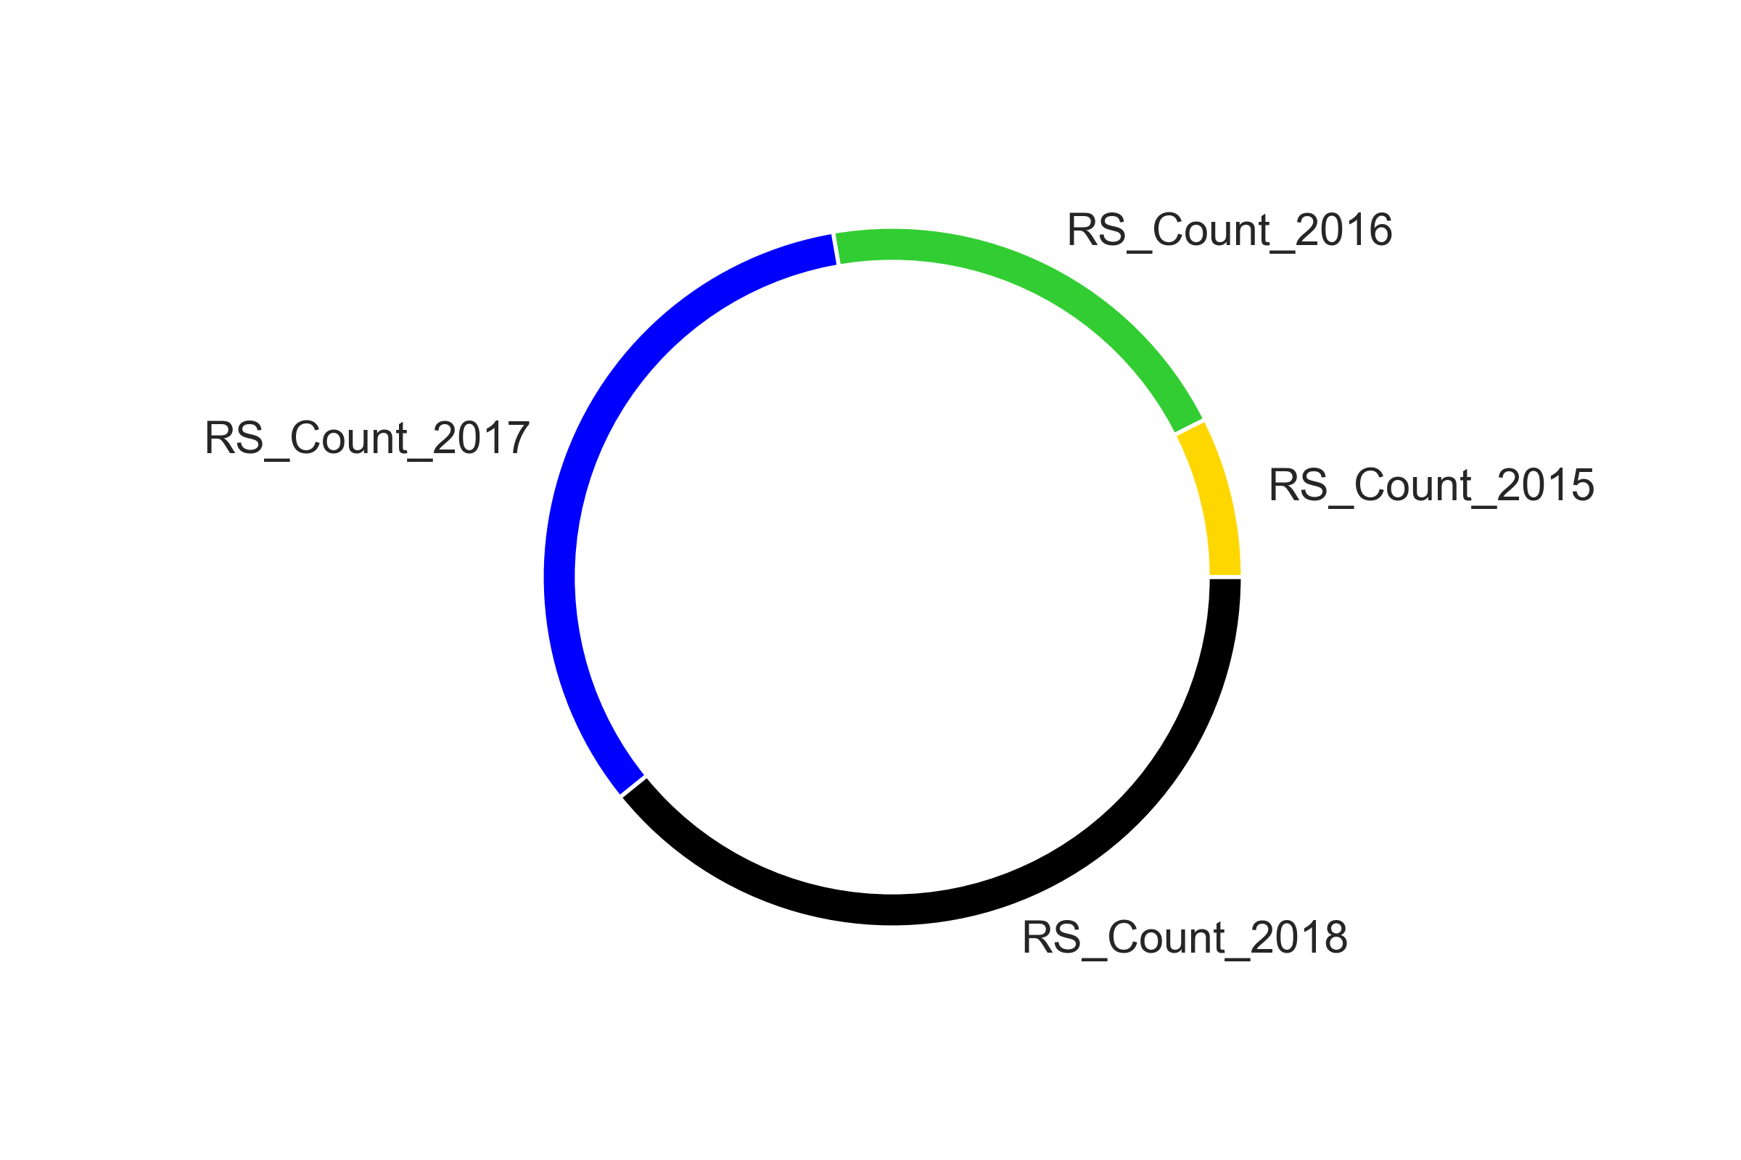
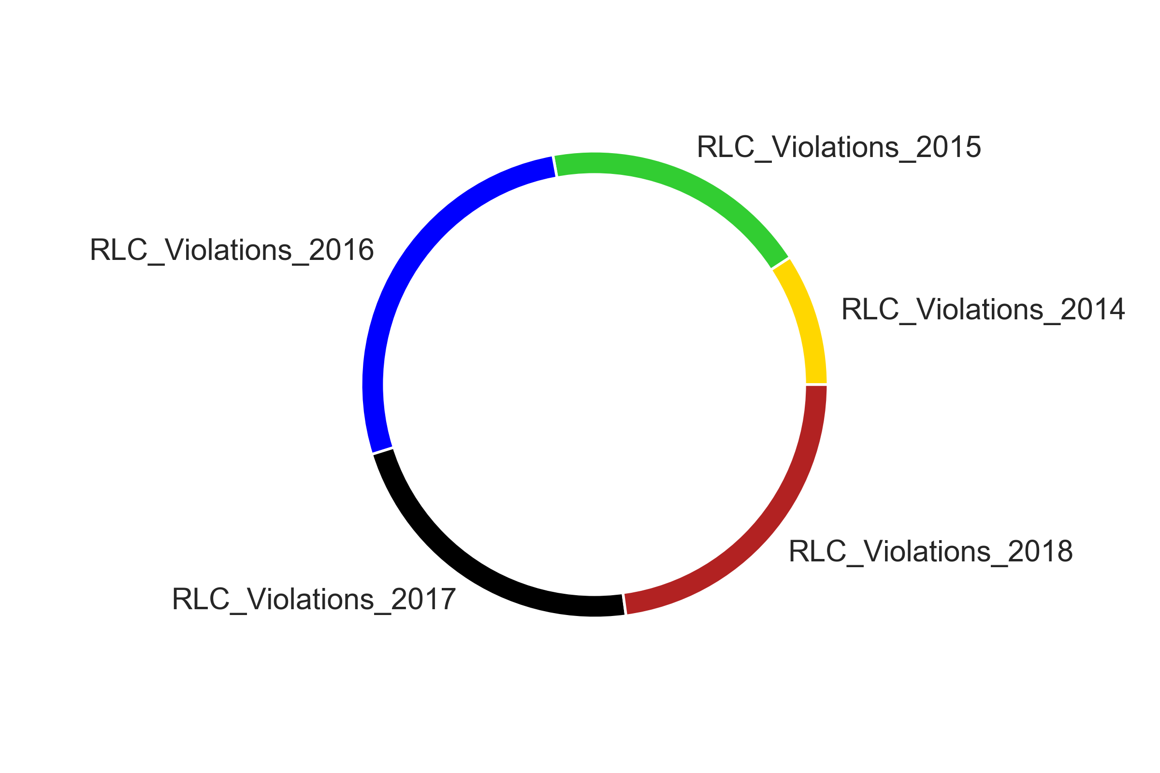
Ride Share Count Growth
(2015-2018)
Red Light Camera Violation Growth (2014-2018)

Slide 21
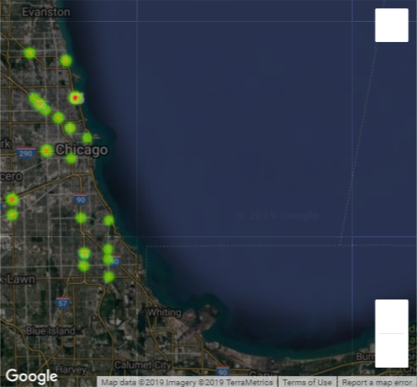
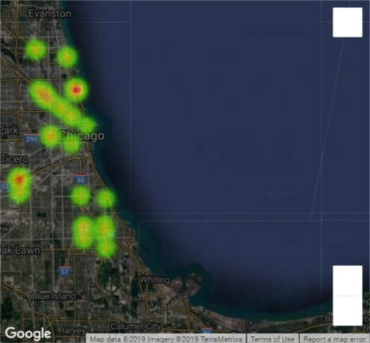

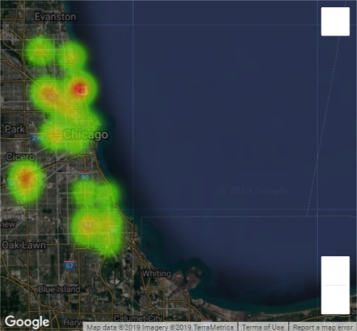
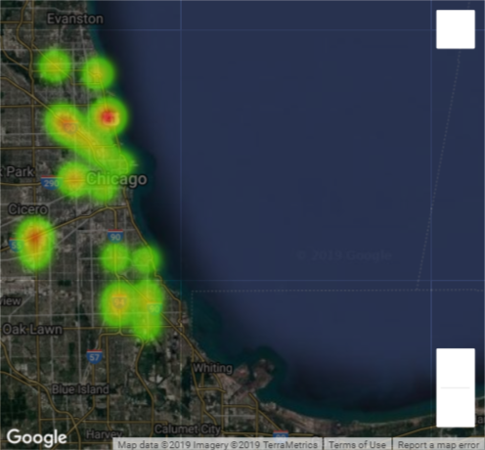
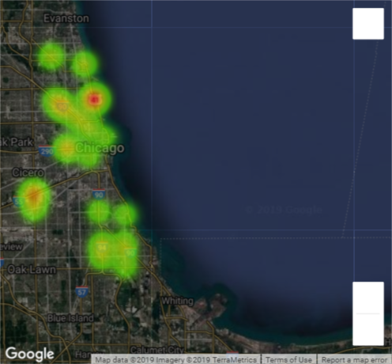
RLC_2014
RLC_2015
RLC Behavior
2014-2018
RLC_2016
RLC_2017
RLC_2018

Slide 22
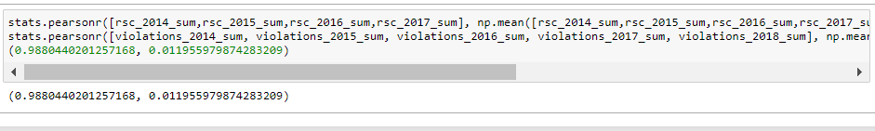
Pearson correlation test results:
Findings From Study
From 2014 to 2016 the amount of red-light camera violations have tripled.
From 2014 to 2017 the amount of rideshare rides have grown an astonishing 600%.
Pearson correlation coefficient: 0.98
P-Value: 0.011955979874283209
Positive correlations imply that as x increases, so does y.
0.98 There fore this hypothesis states that as rideshare counts increase so will the amount of violations.
With a P-Value: of roughly 0.012 most would reject the null hypothesis.
Leave it up to you.
Possible Solutions
Eventually set a cap on the number of drivers who can drive for Uber and Lyft.

